Slide 1
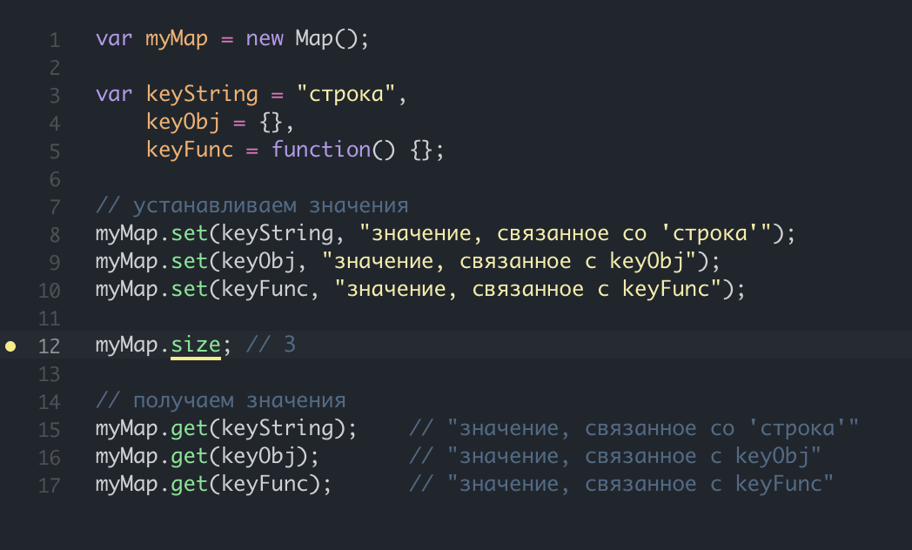
Map
методы:
delete(key), clear(), has(key), get(key), set(key, value), size
итерация:
keys(), values(), entries()

Slide 2
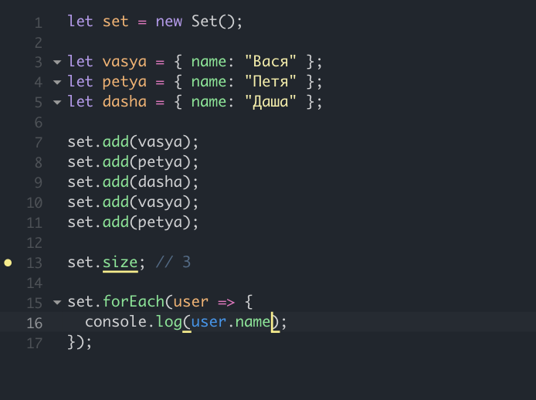
Set
методы
add(item), delete(item), has(item), clear()

Slide 3
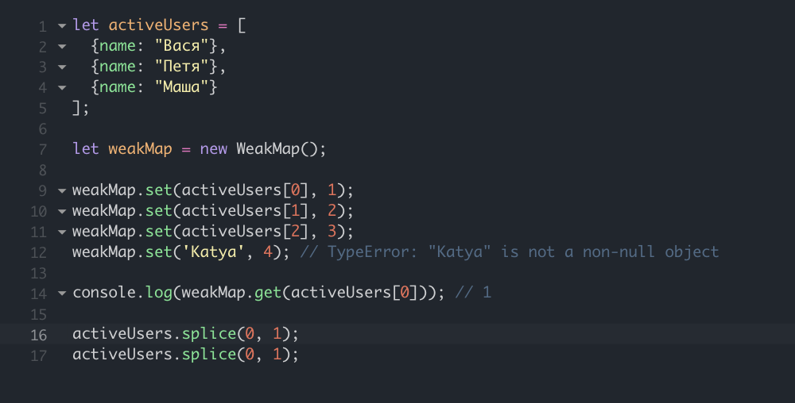
WeakMap и WeakSet
delete(key), has(key), get(key), set(key, value)
delete(value), has(value), get(value), add(value)
clear(), size, forEach

Slide 4
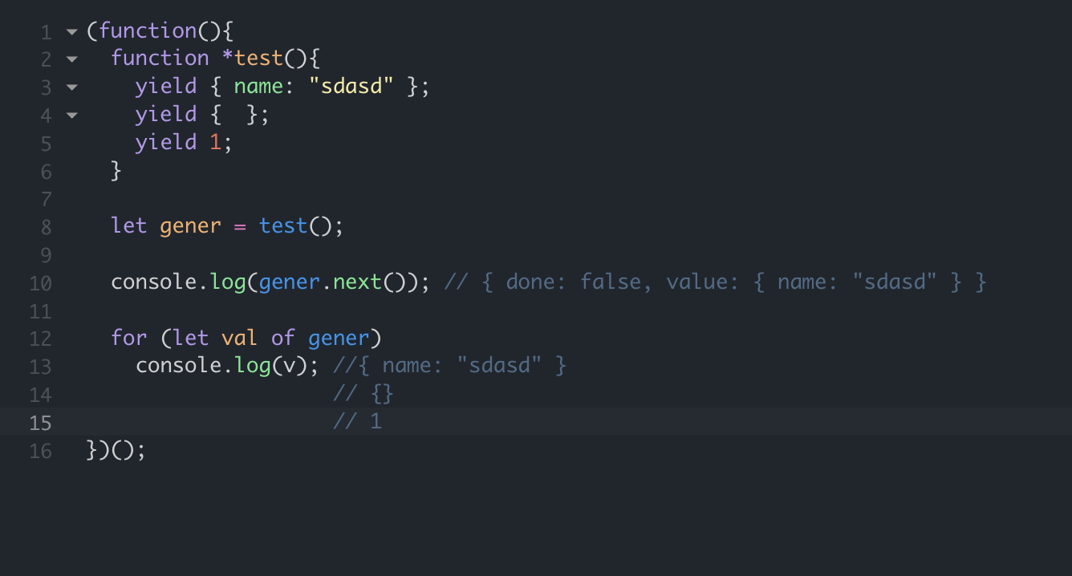
Генераторы

